Slide 1
Continues Assessment
WQD 7005 - DATA MINING
Milestone 2 - Management of Data
Store Data into HIVE Data Warehouse
Instructor Professor Dr. Teh Ying Wah
Group members
Gunasegarran Magadevan | 17043640
Liu Hong Yang | 17201091

Slide 2
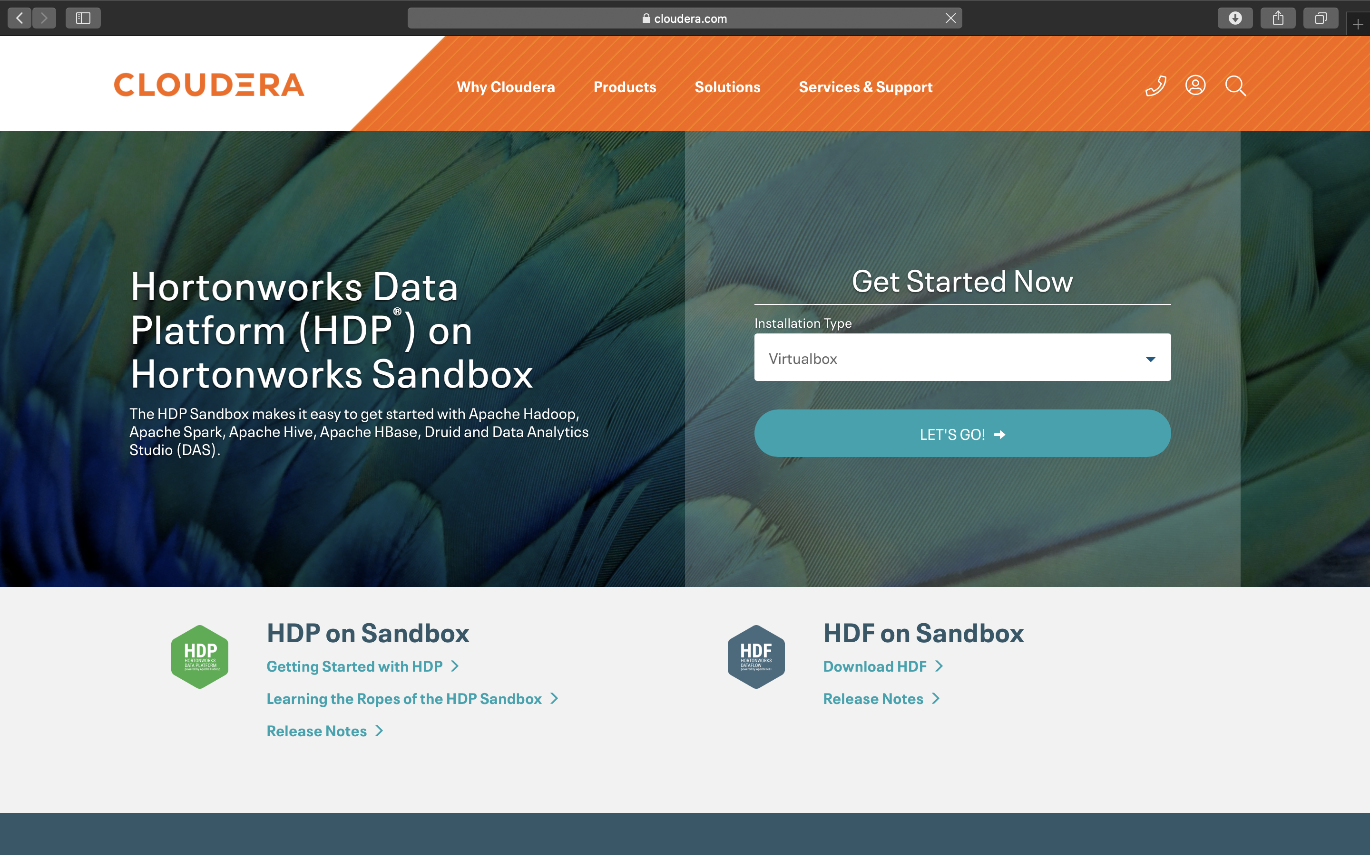
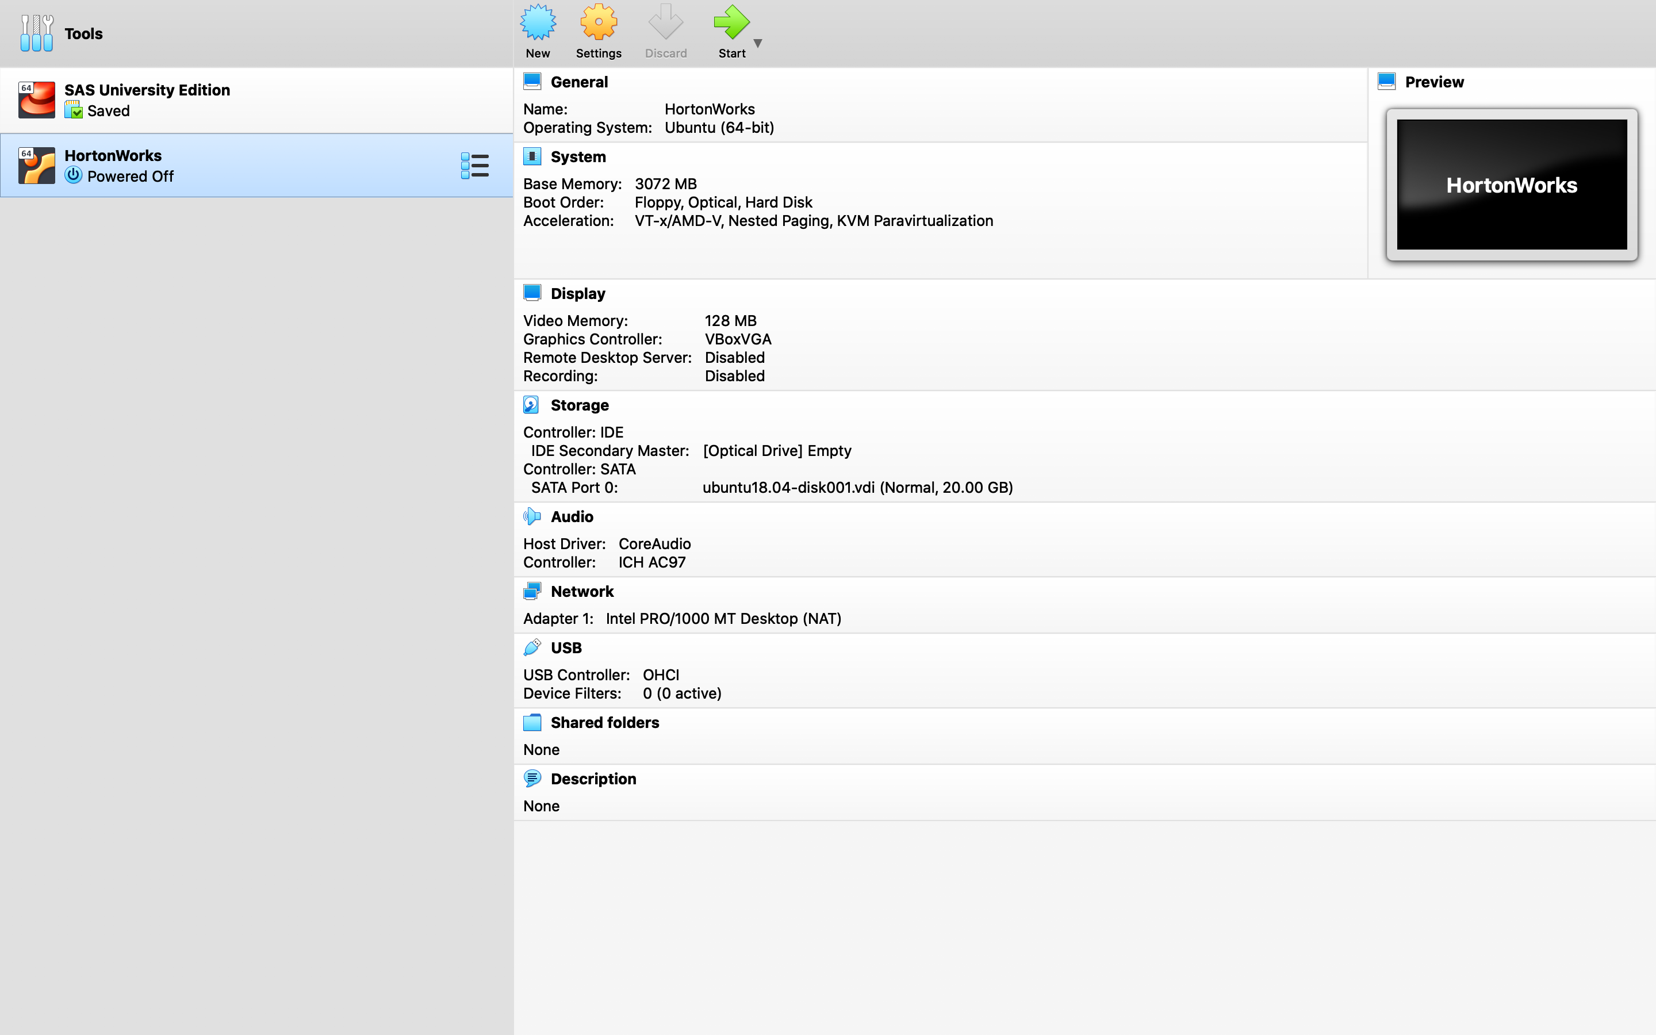
1. Downloading Hortonworks Sandbox:
https://www.cloudera.com/downloads/hortonworks-sandbox/hdp.html
2. Importing the downloaded HortanWorks.ova in VirtualBox

Slide 3
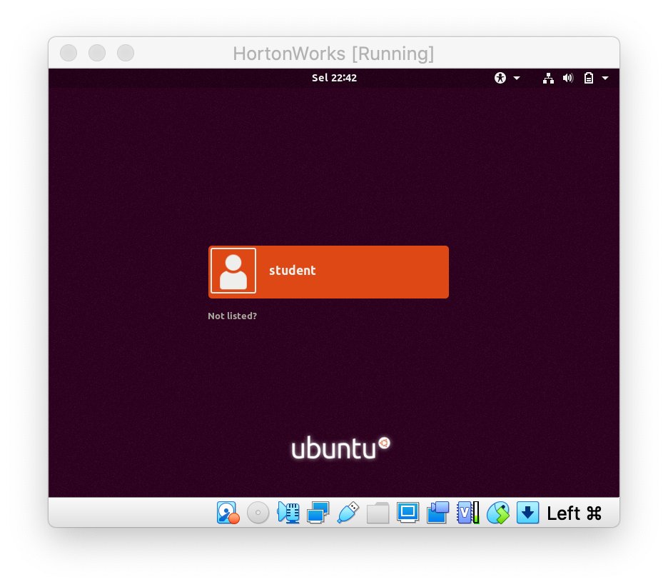
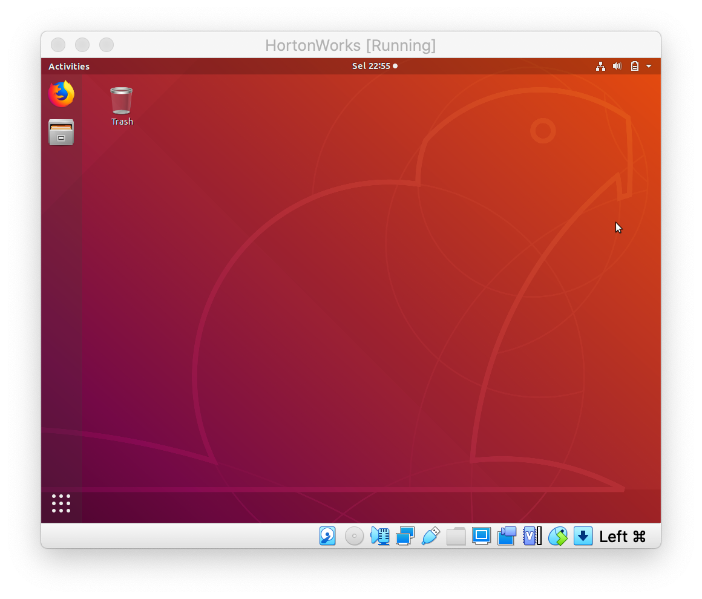
3. Launch HortonWorks in VirtualBox
4. Successfully login to HortonWorks using Student credential

Slide 4
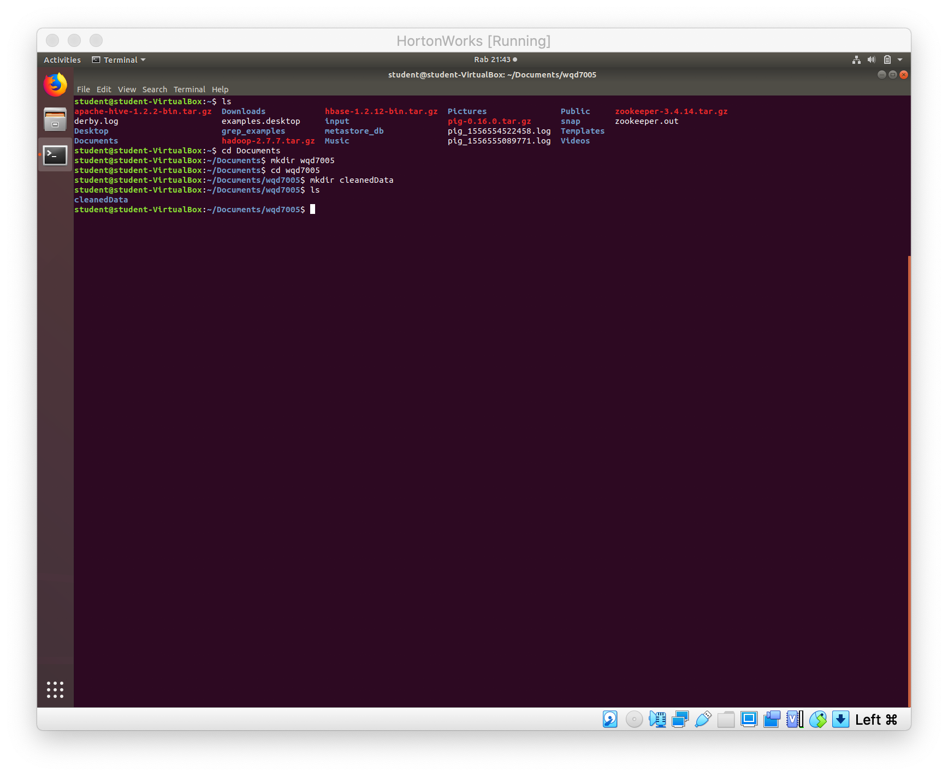
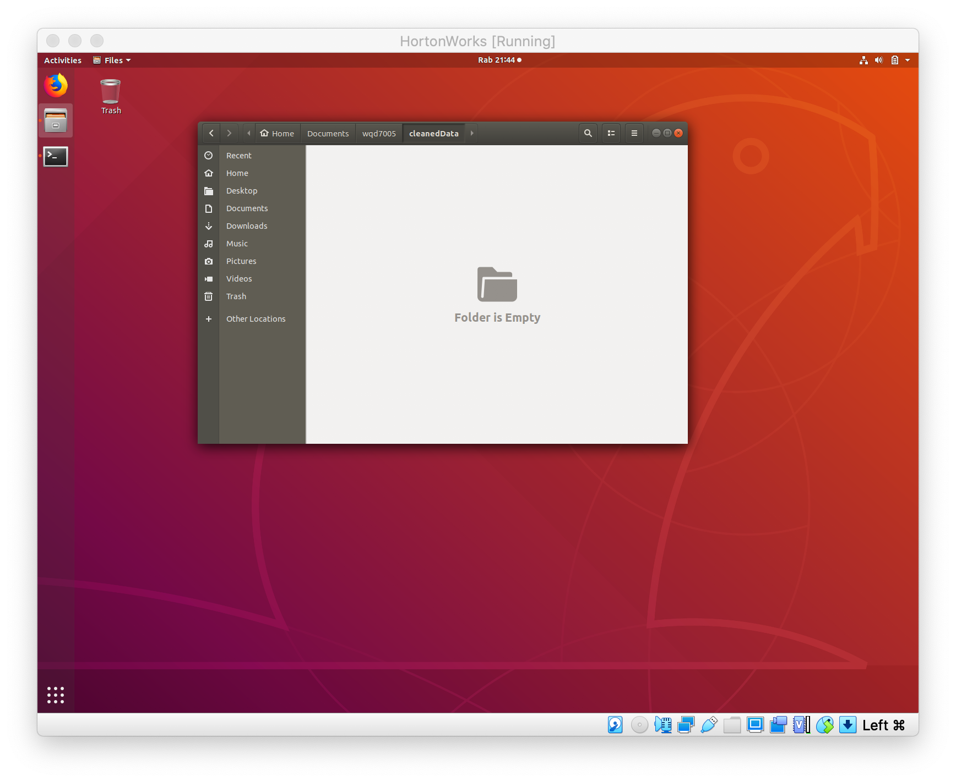
5. Created a directory into local system.

Slide 5
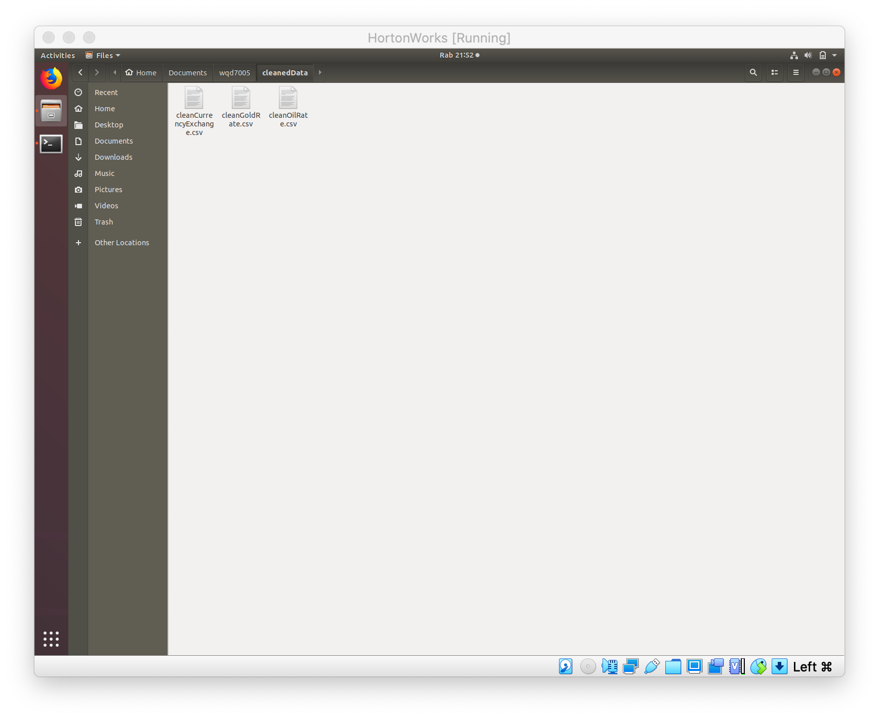
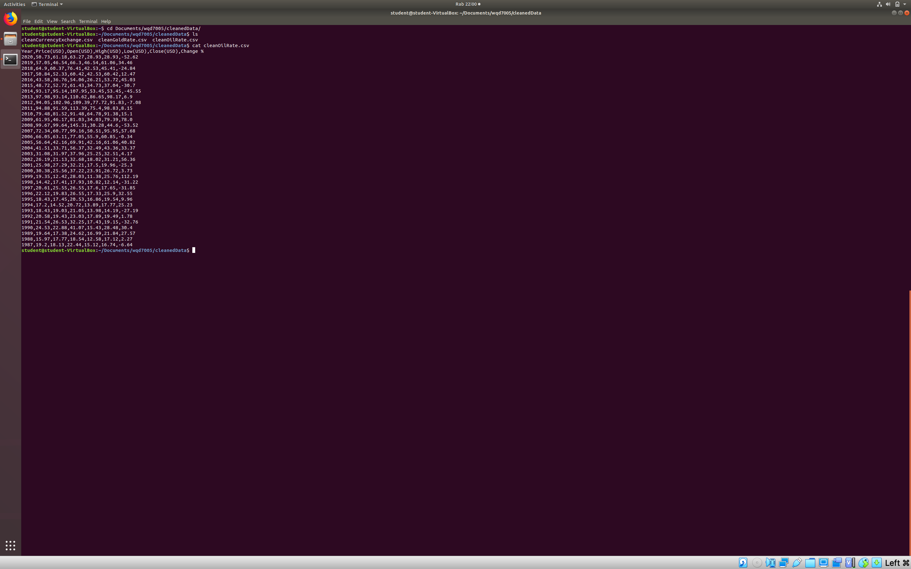
6. Copy the cleaned data into newly created directory.
7. Locate the copied data and view the data files.

Slide 6
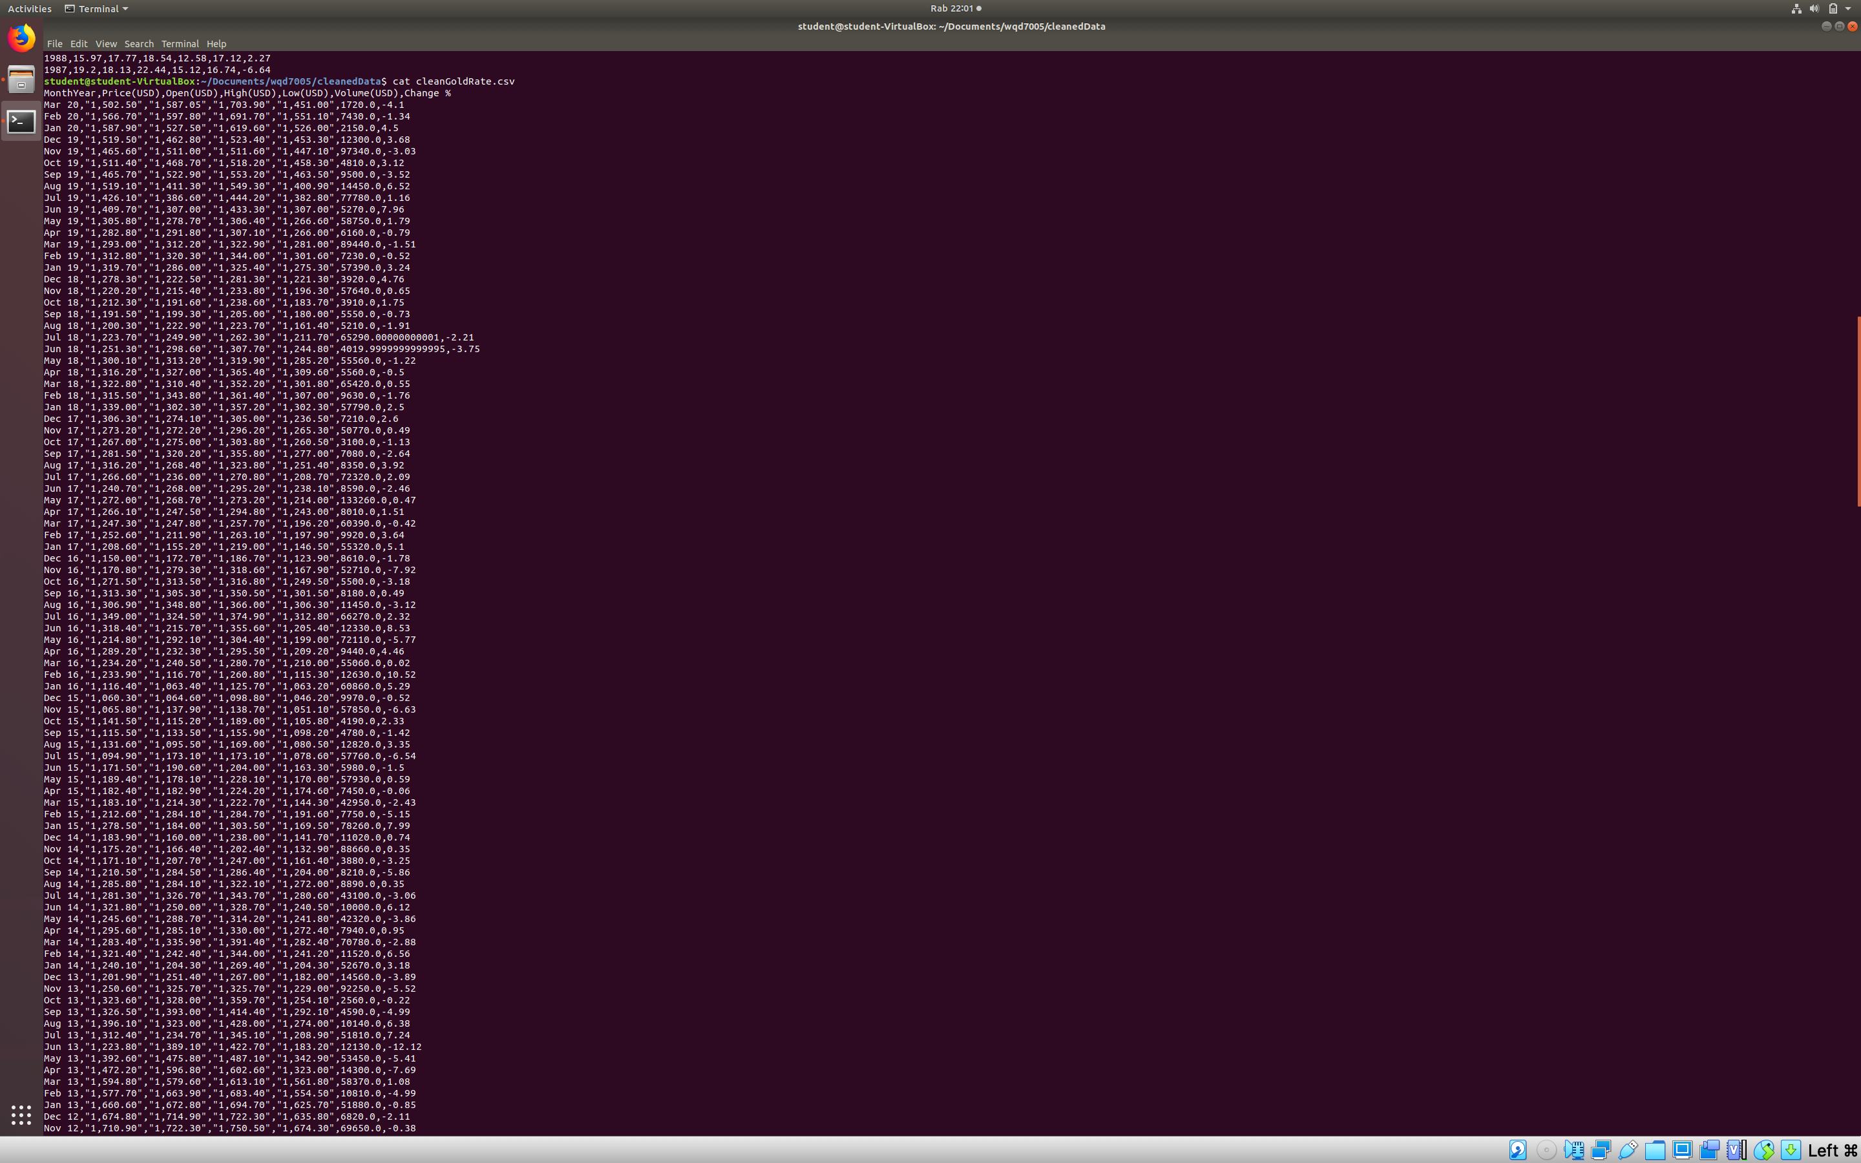
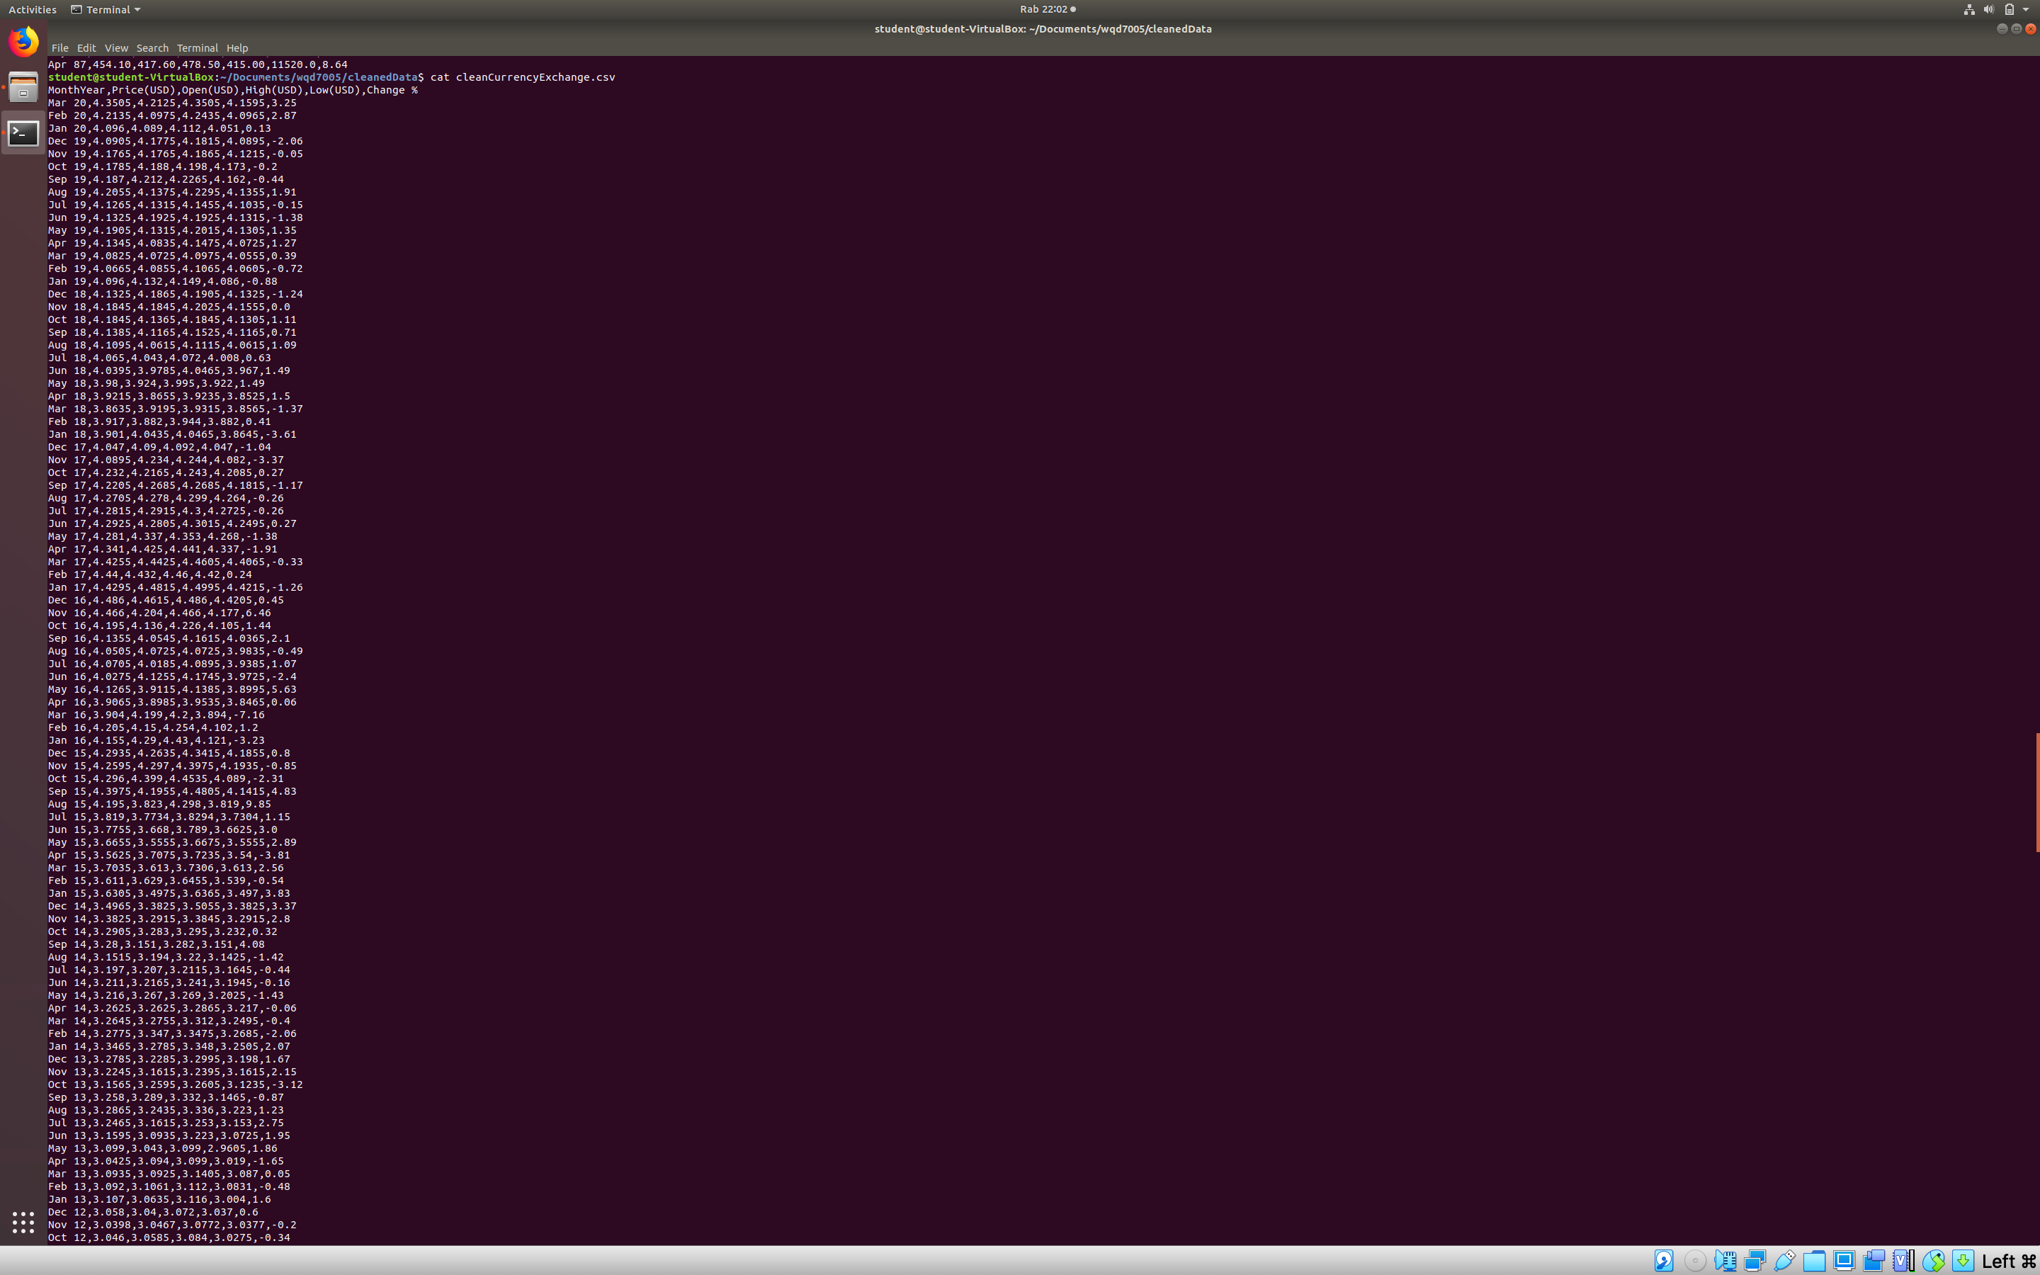

Slide 7
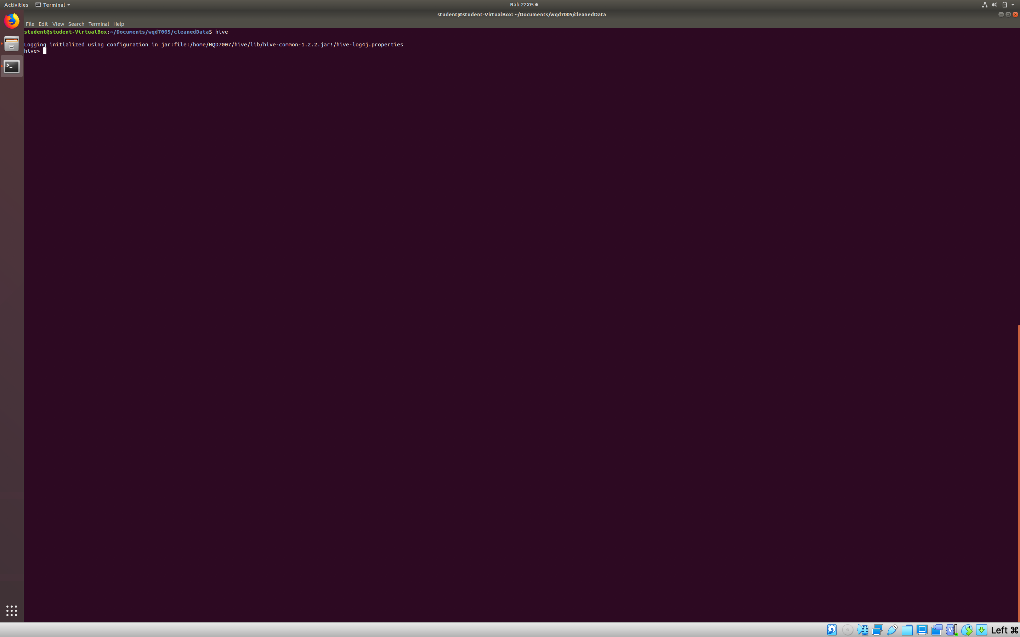
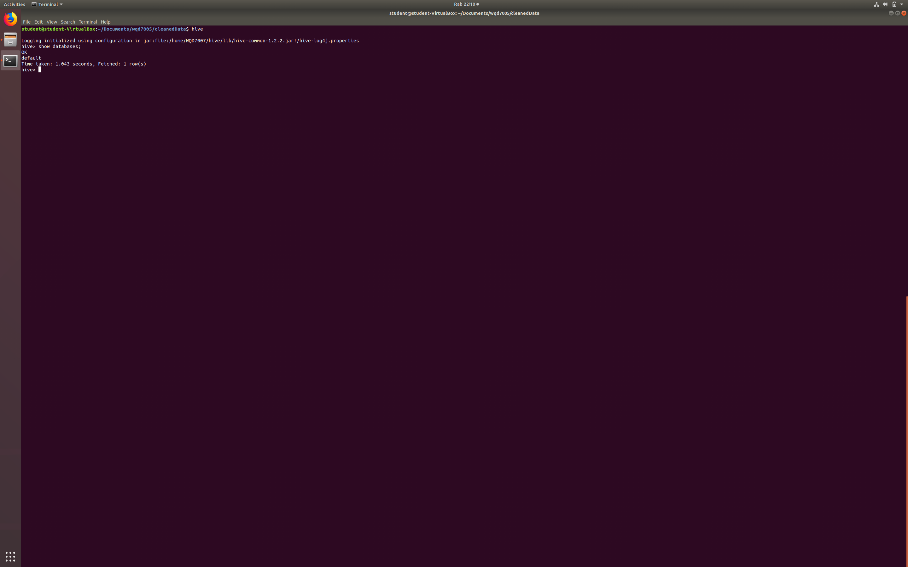
8. Launching “HIVE”.
9. Checking any existing databases.

Slide 8
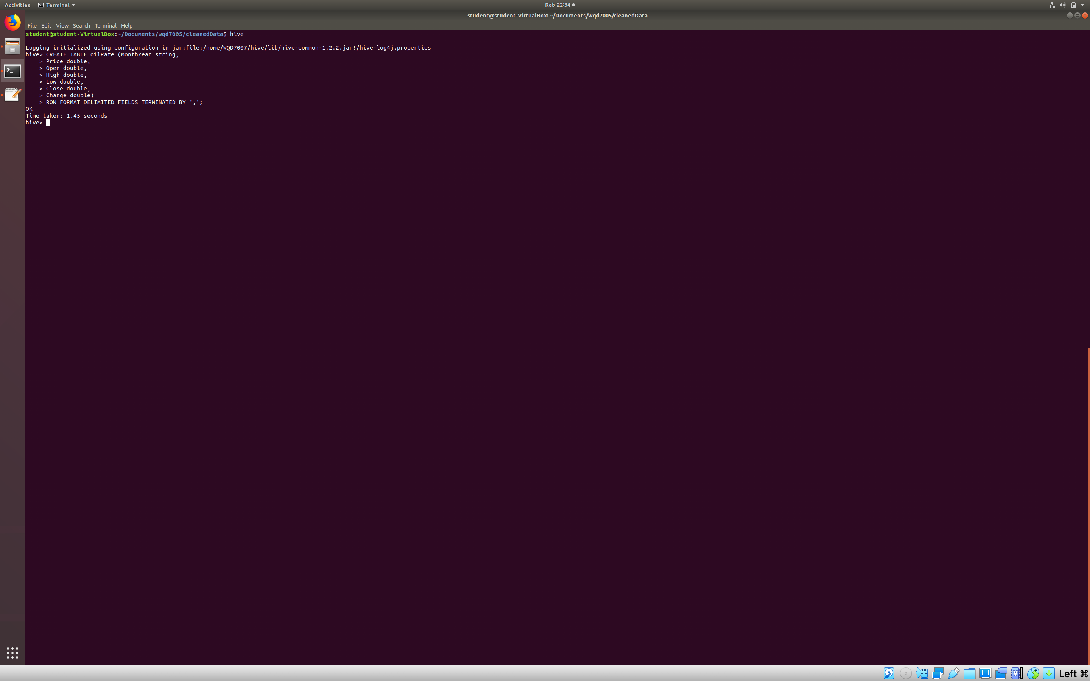
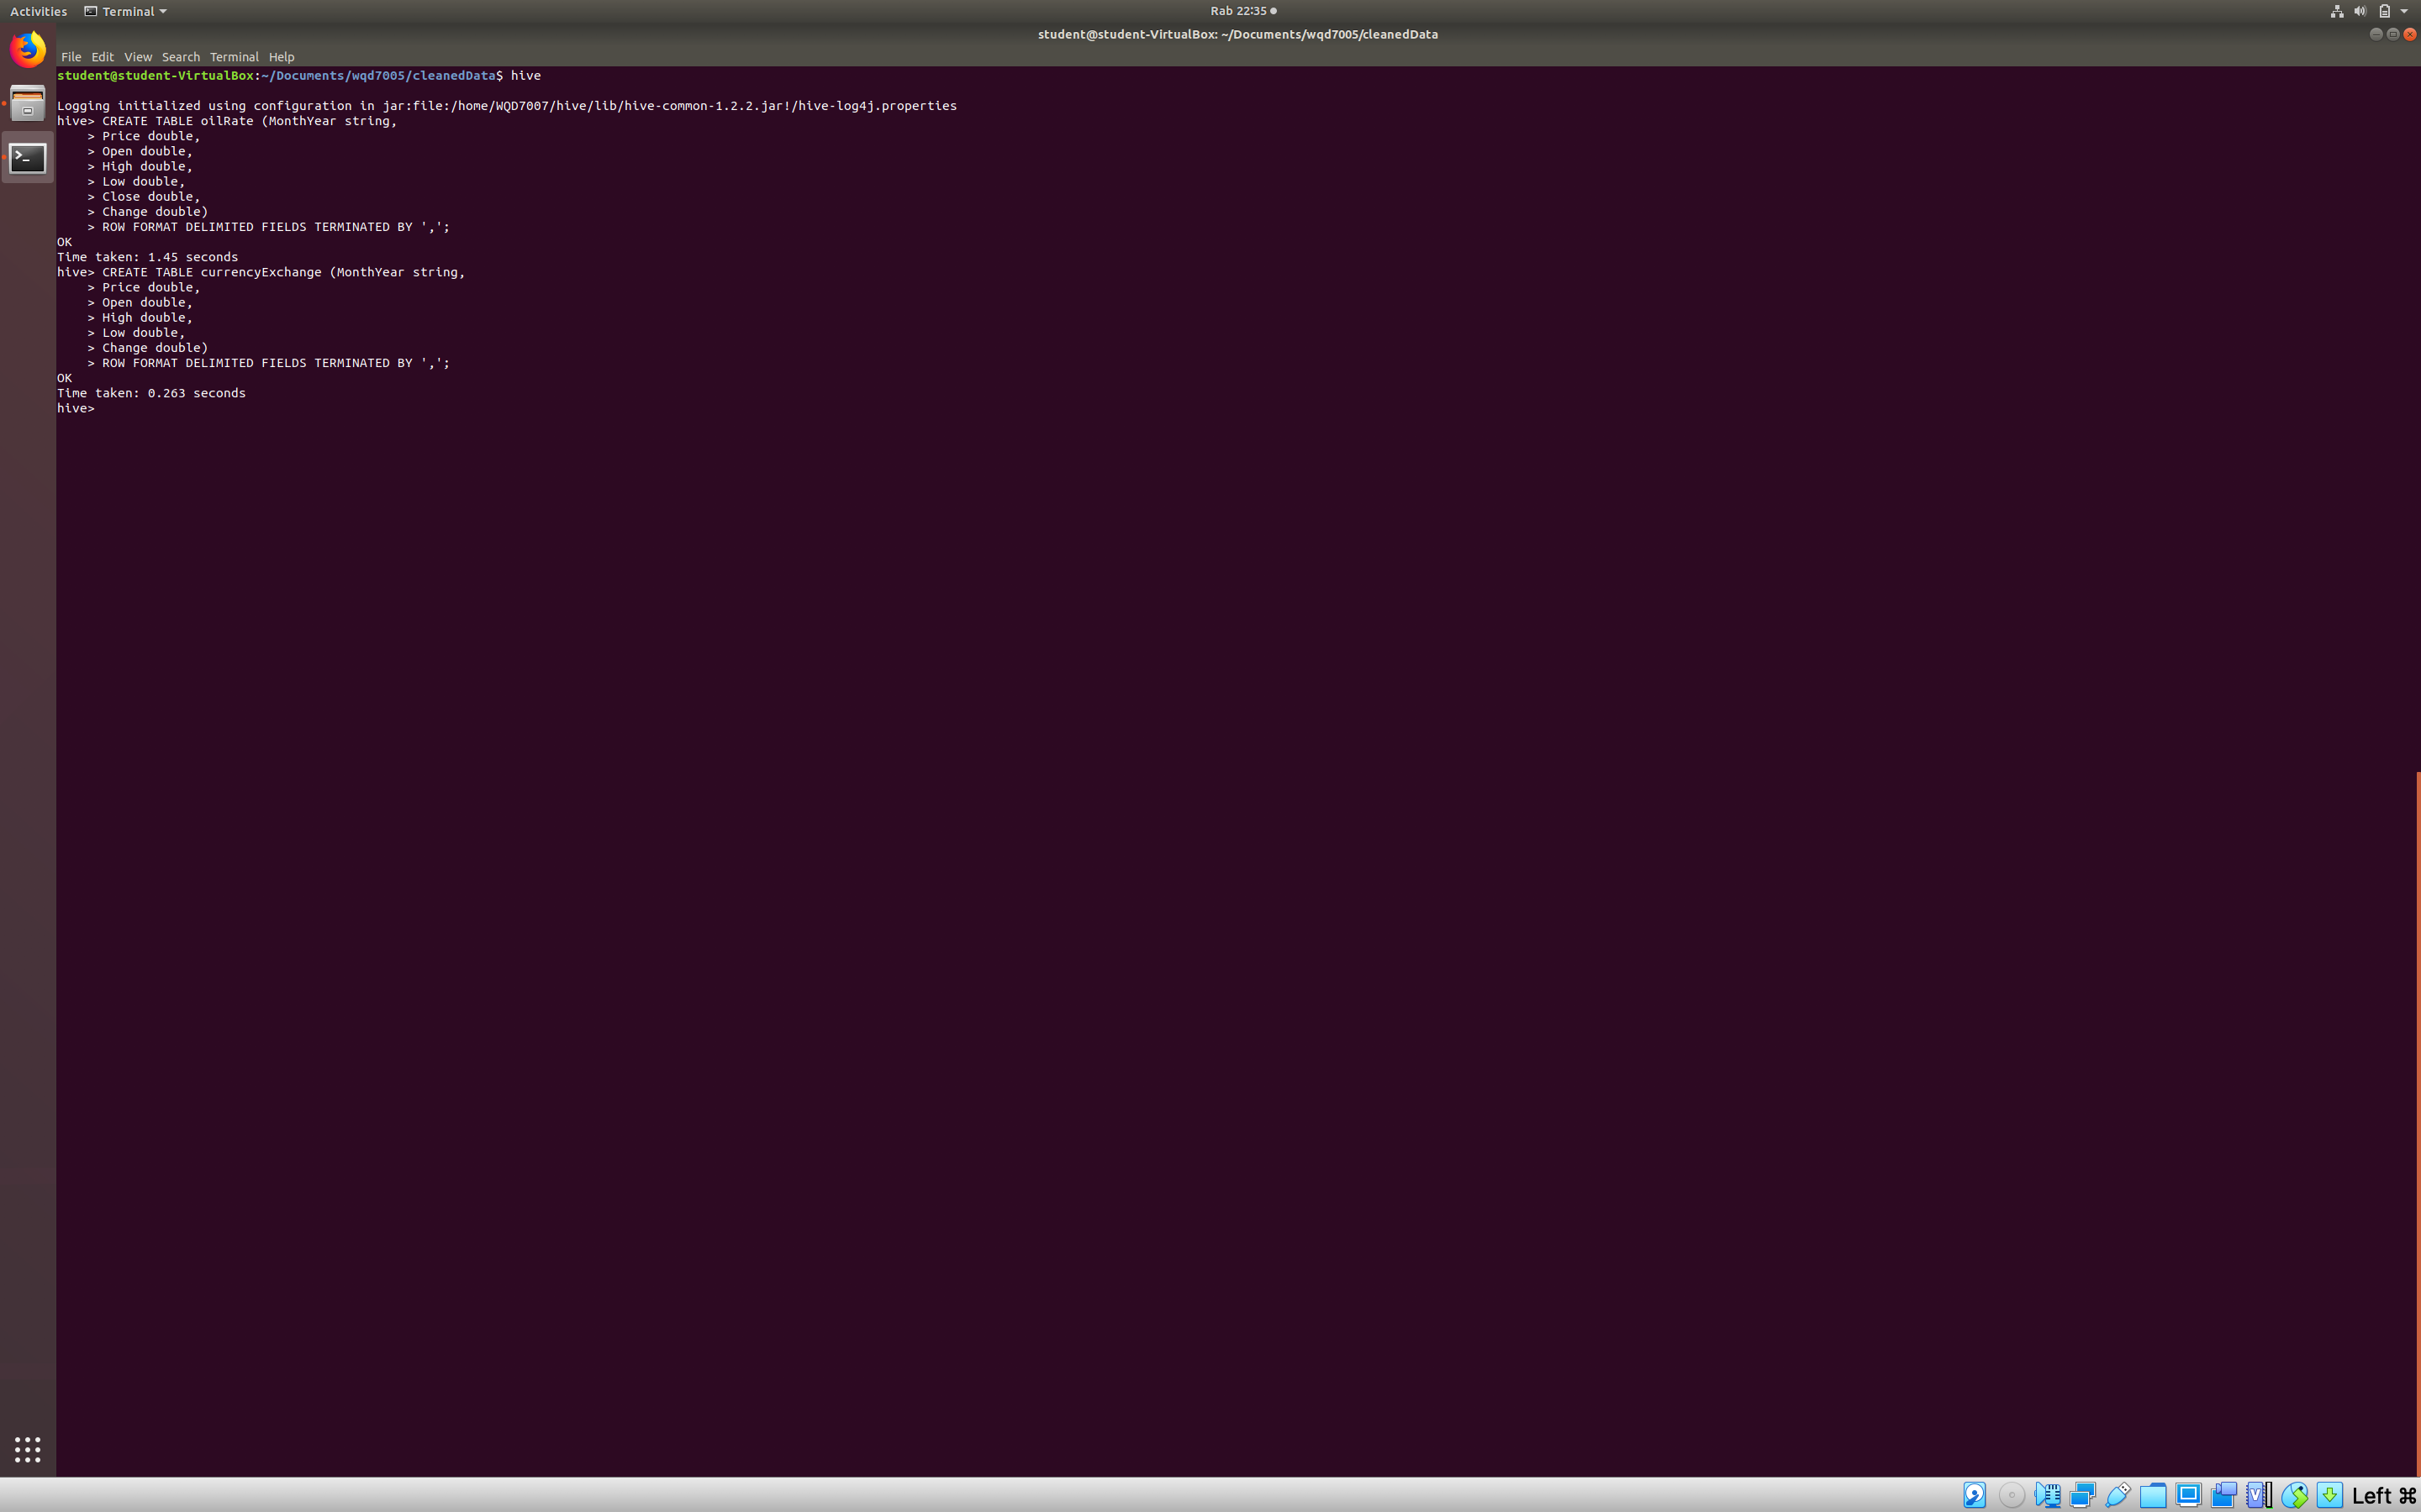
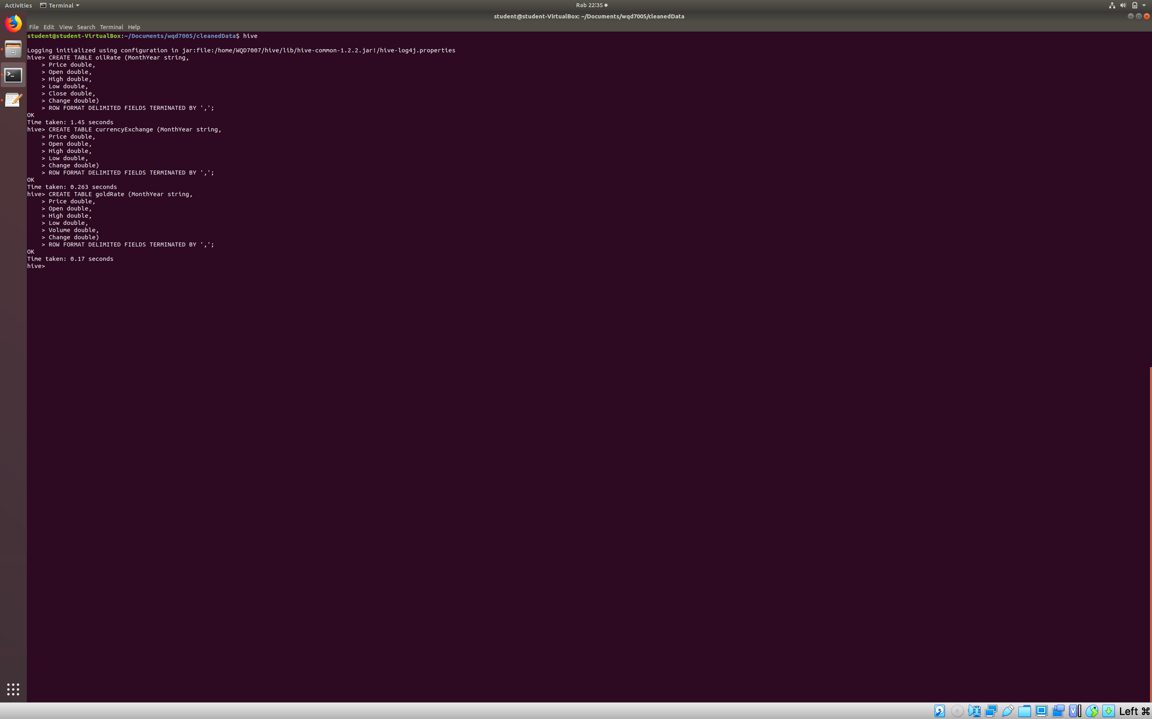
10. Create new tables for the cleaned data with defining all the required columns.

Slide 9
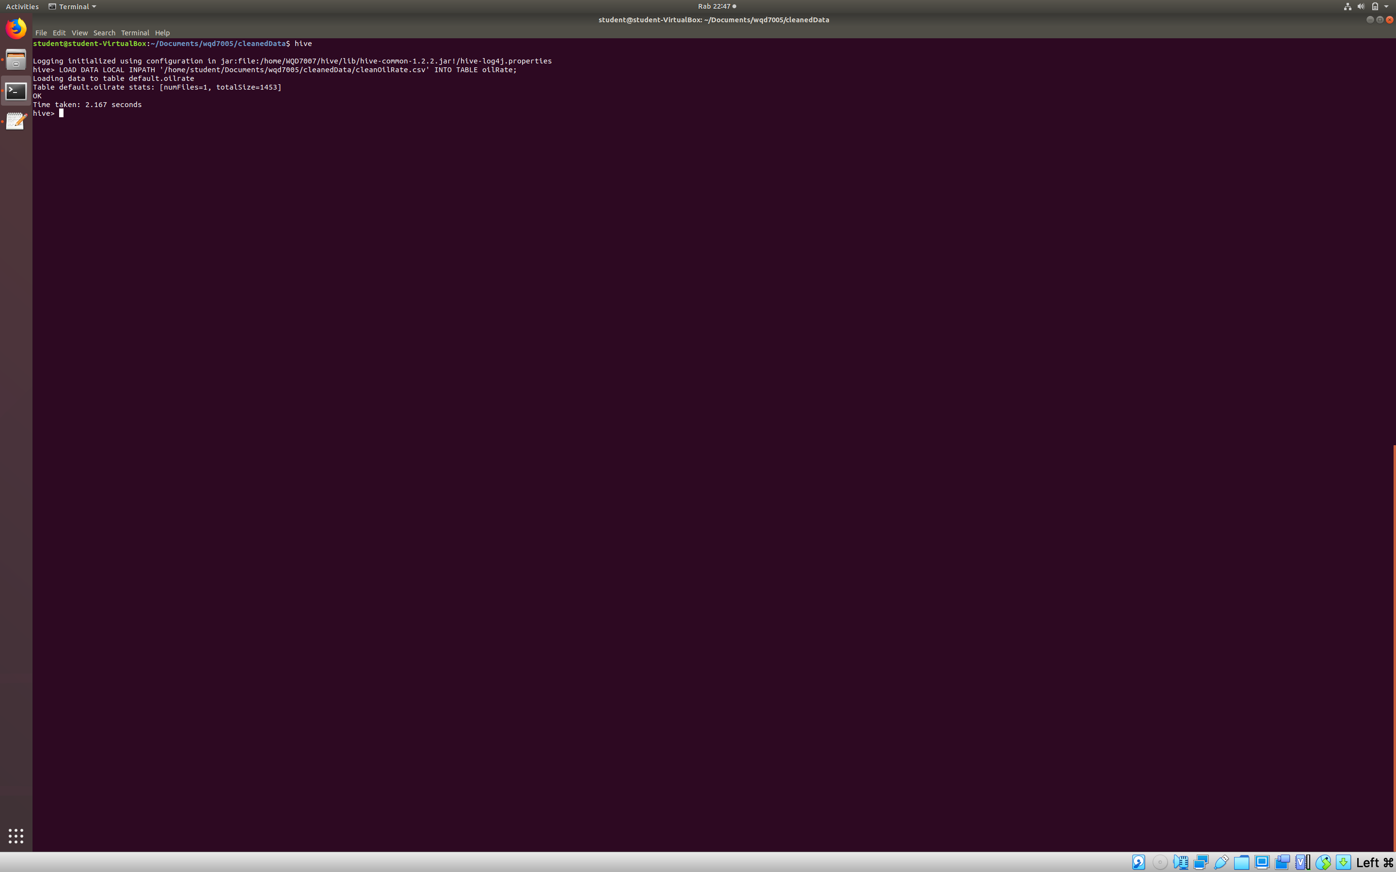
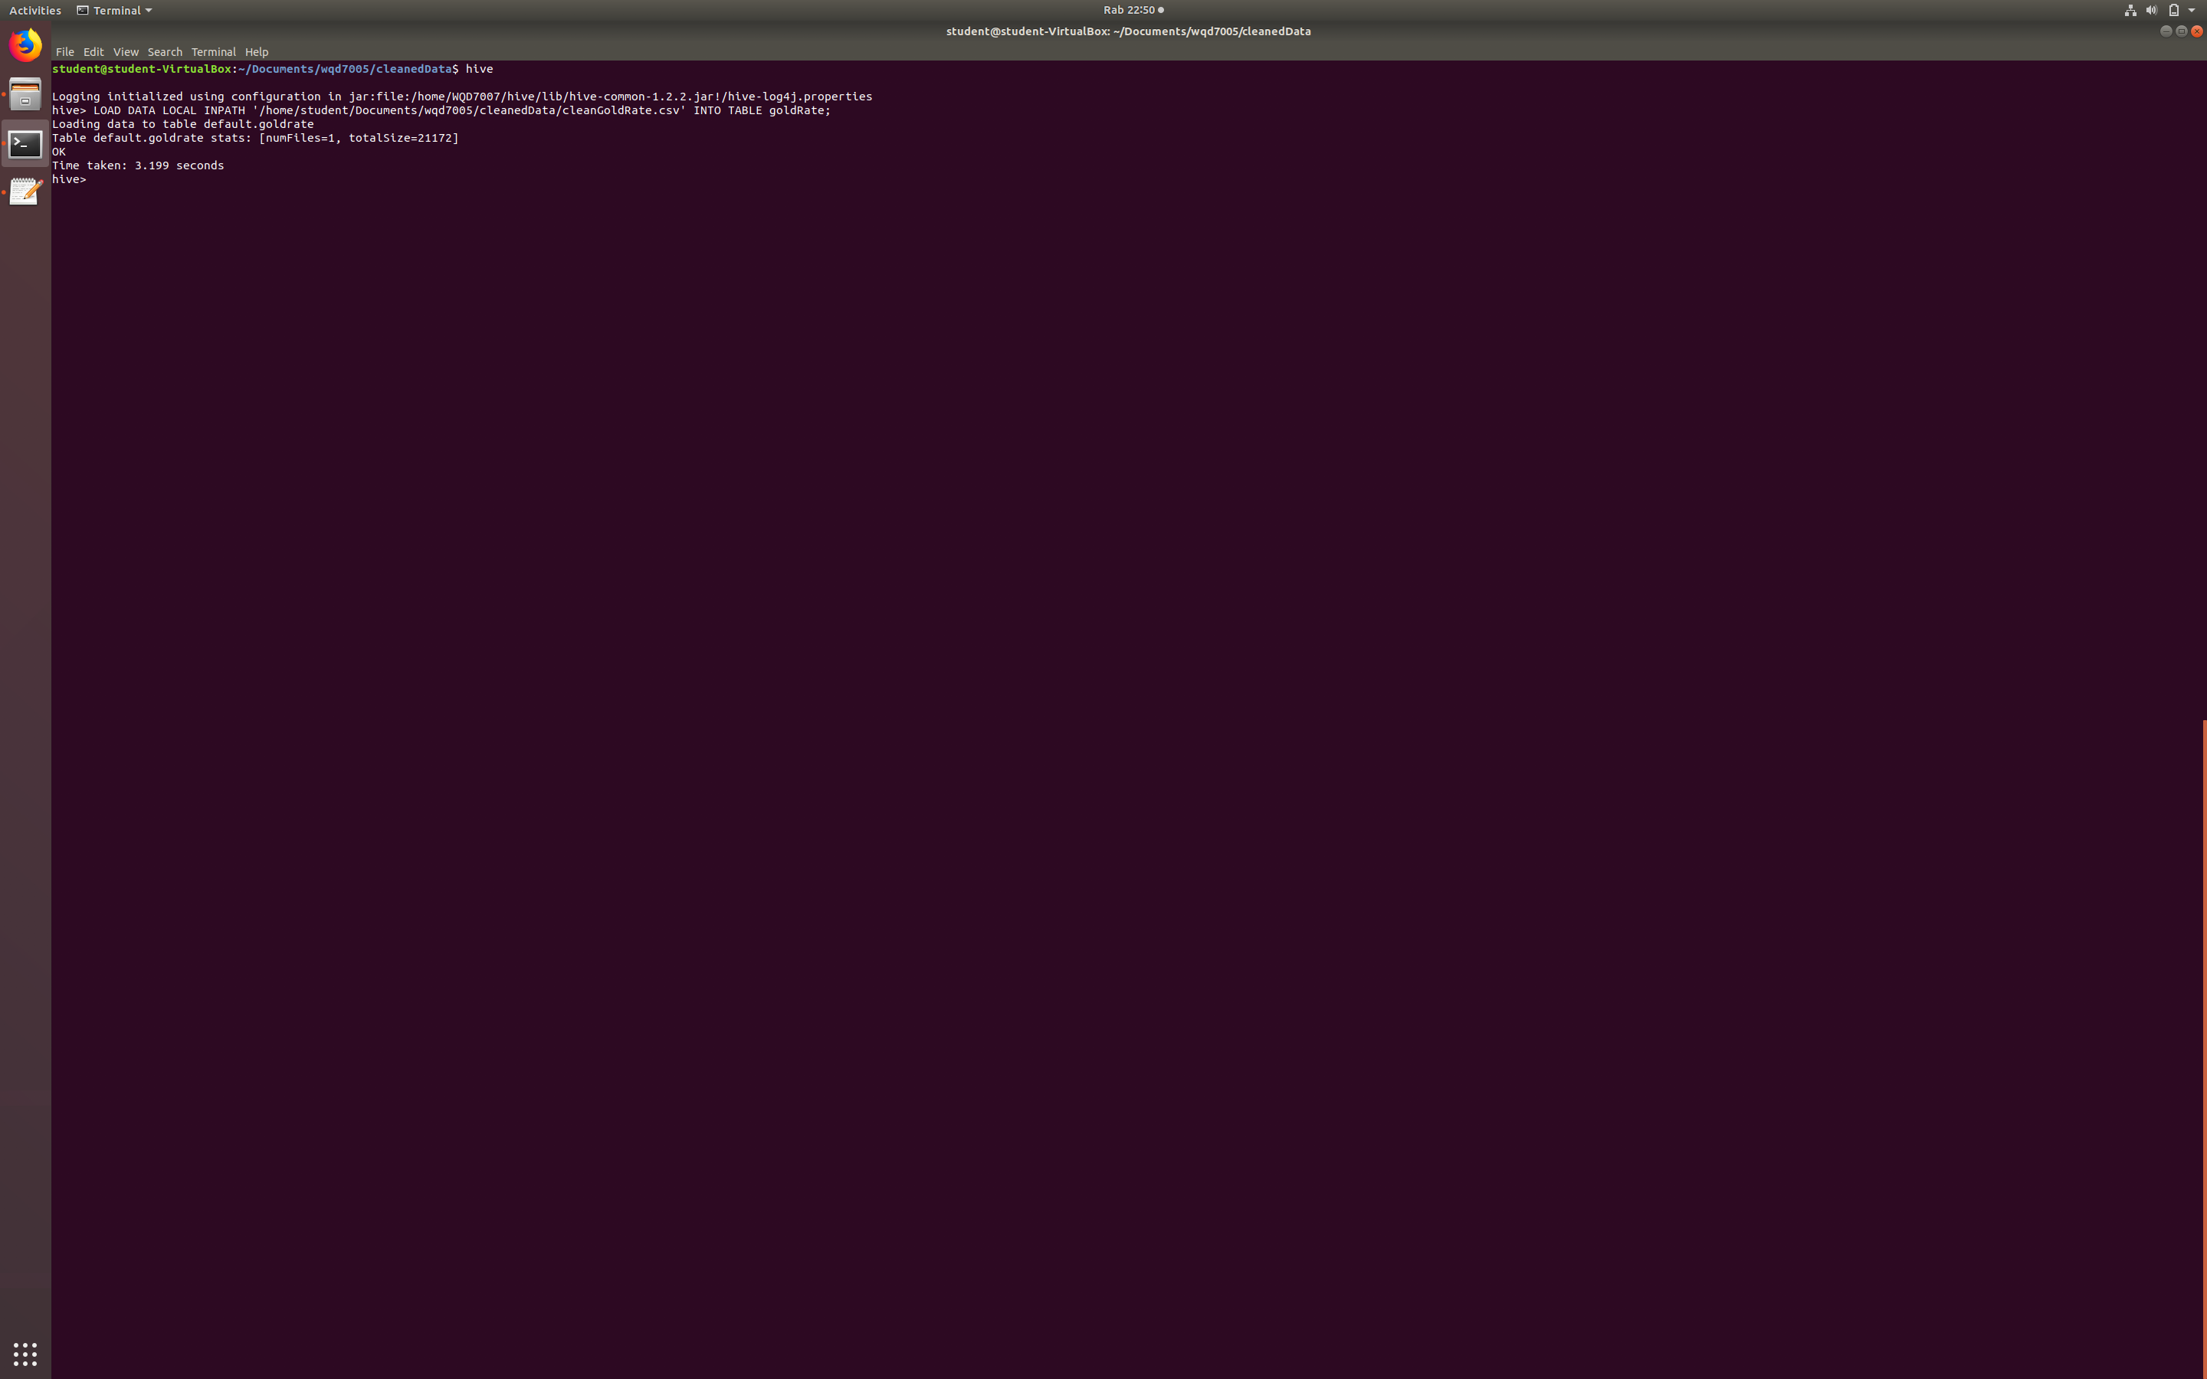
11. Load data from local file system into hive table.

Slide 10
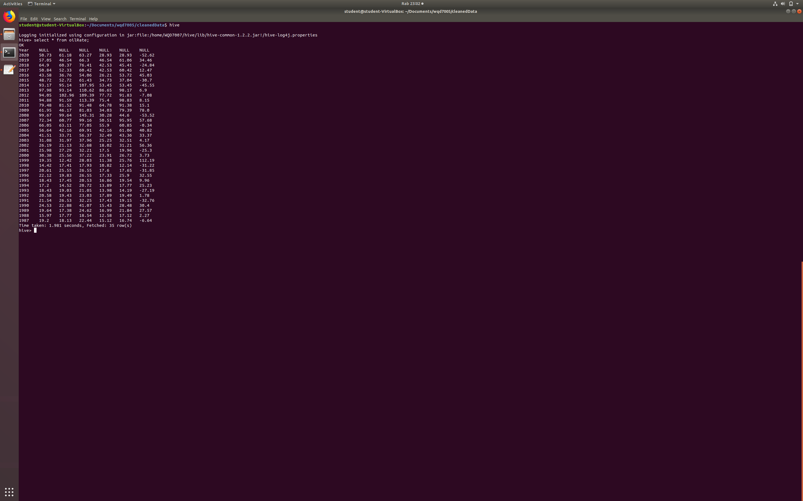
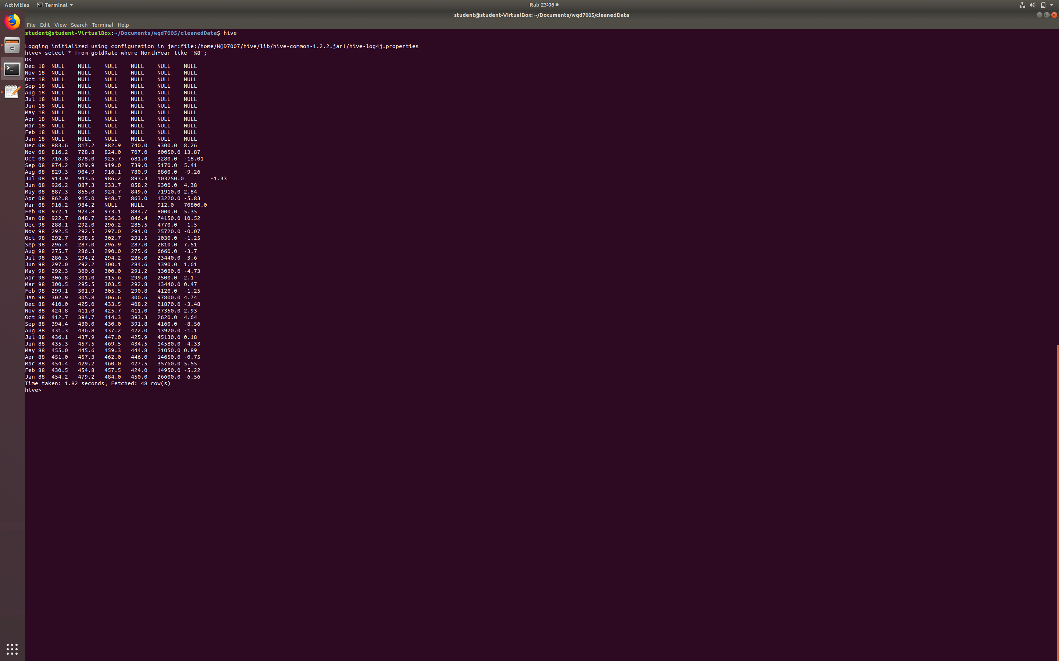
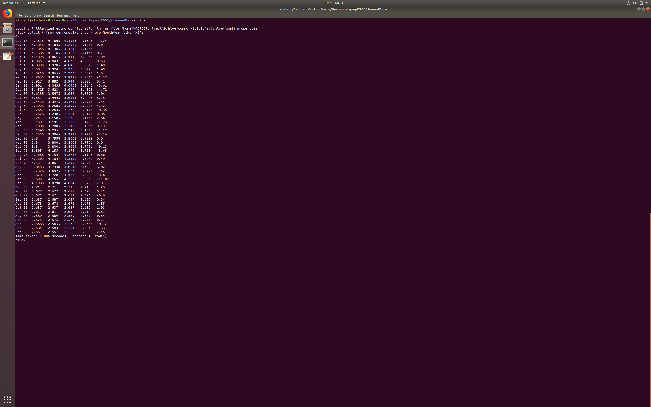
12. Check and verified the data are successfully loaded into HIVE table (data warehouse).

Slide 11
THANK
YOU

